Slide 1
Define Stage of Design Thinking

Slide 2
The define stage is the second step in the design thinking process, following the empathize stage. It's where you take all the information you gathered about your users in the empathize stage and turn it into a clear, actionable problem statement.
We take the raw data from the Empathize Stage and refine it into actionable insights. Through analysis and synthesis, we identify the central challenges faced by users. Finally, we translate these challenges into a clear problem statement that becomes the cornerstone for the design process

Slide 3
In the design thinking process, we empathize with users in the first stage. We step into their shoes, understand their needs and challenges. But empathy on its own isn't enough. In the Define stage, we take all that user research and turn it into a clear, actionable problem statement. This focused problem statement guides the rest of the design process.

Slide 4
The define stage ensures you fully understand the goal of your design project and provides a clear-cut objective to work towards.
Without a well-defined problem statement, it’s hard to know what you’re aiming for. Your work will lack focus, and the final design will suffer.

Slide 5
What is the Define Stage?
The Define stage is the second stage of the design thinking process.
It follows the Empathize stage, where we gather user research.
In Define, we synthesize that research to define the core problem we're trying to solve.

Slide 6
Why is Define Important?
A well-defined problem statement is critical for the success of the entire design thinking process.
It ensures everyone is on the same page about the problem we're solving.
It helps us avoid solution bias and focus on creating solutions that truly address user needs.
A clear problem statement keeps us focused and prevents us from going down rabbit holes.

Slide 7
Activities in the Define Stage
Synthesis: We look for patterns and insights in the data. What are the recurring themes? What are the biggest challenges users face?
Problem Statement Formulation: We craft a clear, concise problem statement that captures the core user need we're trying to address.

Slide 8
What is problem Statement
Identifies the GAP between the problem and the GOAL
user problem = unmet need
Designing a solution - meets this need, you can satisfy the user and ensure a pleasant UX.
A problem statement, or point of view (POV) statement, frames this problem (or need) in a way that is actionable for designers.
It provides a clear description of the issue that the designer seeks to address, keeping the focus on the user at all times.

Slide 9
Crafting a Problem Statement
A good problem statement follows a specific format, often phrased as a HMW (How Might We) question.
It focuses on the user's need and the context in which it arises.
It avoids solution bias and doesn't specify how the problem should be solved.

Slide 10
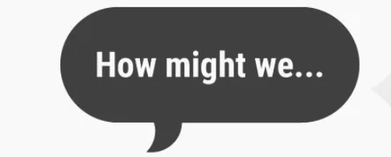
“How Might We” Questions Frame
You start using your POV by reframing the POV into a question: Instead of saying, we need to design X or Y, It’s time to start using the Design Thinking Method where you ask, “How Might We…?”
For example: How might we… design a driverless car, which is environmentally friendly, cheap and easy for more people to share?

Slide 11
The How Might We question opens up the exploration space to a range of possibilities.
"How" suggests that we do not yet have the answer. “How” helps us explore a variety of endeavors instead of merely executing on what we “think” the solution should be.
"Might" emphasizes that our responses may only be possible solutions, not the only solution. “Might” also allows for the exploration of multiple possible solutions, not settling for the first that comes to mind.
"We" immediately brings in the element of a collaborative effort. “We” suggests that the idea for the solution lies in our collective teamwork.

Slide 12
Point Of View (POV)
A Point Of View (POV) is a meaningful and actionable problem statement, which will allow you to ideate in a goal-oriented manner.
A POV involves reframing a design challenge into an actionable problem statement.
You articulate a POV by combining your knowledge about the user you are designing for, his or her needs and the insights which you’ve come to know in your research or Empathize mode.
Your POV should be an actionable problem statement.
You articulate a POV by combining these three elements – user, need, and insight.

Slide 13
In the Define mode, you should end up creating an actionable problem statement which is commonly known as the Point Of View (POV).
In the Design Thinking process, you will gain insights from your research and fieldwork in the Empathize mode.
Your POV should never contain any specific solution, nor should it contain any indication as to how to fulfill your users’ needs in the service, experience, or product you’re designing.
Instead, your POV should provide a wide enough scope for you and your team to start thinking about solutions which go beyond status quo.

Slide 14
Step 1: How do you Define your Point Of View?
Define the type of person you are designing for – your user. For example, you could define the user by developing one or more Persona, empathy maps and other methods, which help you to understand and crystallize your research results – observations, interviews, fieldwork, etc.
Select the most essential needs, which are the most important to fulfill. Again, extract and synthesize the needs you’ve found in your observations, research, fieldwork, and interviews.
Work to express the insights developed through the synthesis of your gathered information. The insight should typically not be a reason for the need, but rather a synthesized statement that you can leverage in your designing solution.

Slide 15
Step 2 : Write your definitions
User: Deﬁne the type of person you are designing for – your user. For example, you could deﬁne the user by developing one or more personas, by using affinity diagrams, empathy maps, personas and other methods, which help you to understand and crystallise your research results – observations, interviews, field-work, etc
Needs: Select the most essential needs, which are the most important to full- ﬁll. Again, extract and synthesise the needs you’ve found in your observations, research, ﬁeld-work, and interviews.

Slide 16
Insights: Work to express the insights developed through the synthesis of your gathered information. The insight should typically not be a reason for the need, but rather a synthesised statement that you can leverage in your designing solution

Slide 17
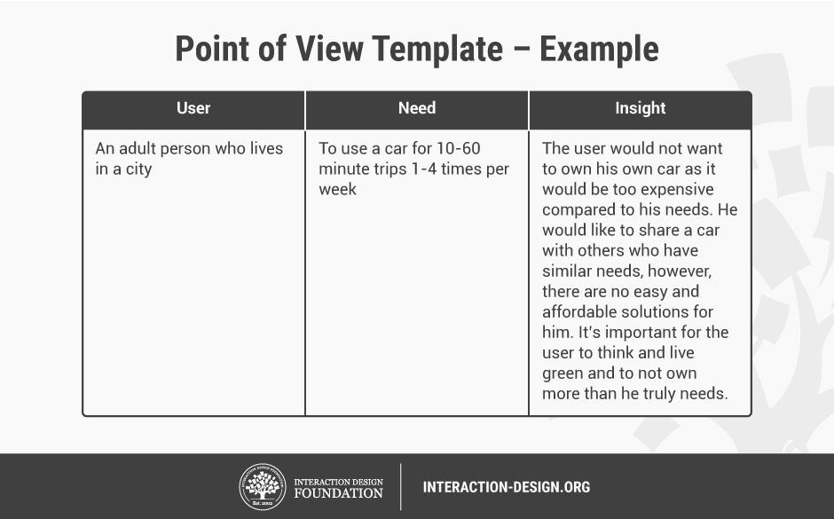
Point Of View template:

Slide 18
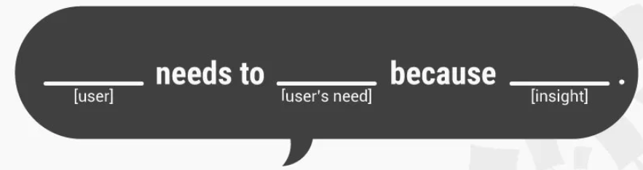
Step 3 – POV Madlib
You can articulate a POV by combining these three elements – user, need, and insight – as an actionable problem statement. You can articulate your POV by inserting your information about your user, the needs and your insights in the following sentence:
[User . . . (descriptive)] needs [Need . . . (verb)] because [Insight . . . (compelling)]

Slide 19
Step 4 – Make Sure That Your Point Of View is One That:
Provides a Clear focus.
Frames the problem as a problem statement.
Inspires your team.
Guides your Innovation.
Informs criteria for evaluating competing ideas.
Is valid, insightful, actionable, unique, clear, meaningful, and exciting.

Slide 20
Example, if POV :
“Teenagers need… to eat nutritious food… in order to thrive and grow in a healthy way.“
The HMW question may go as follows:
How Might We make healthy eating appealing to Teenagers?
How Might We inspire Teenagers towards healthier eating options?
How Might We make healthy eating something, which Teenagers aspire towards?
How Might We make nutritious food more affordable?

Slide 21
What do we focuses on in POV Phase:
We recognize patterns in the needs of the user
We see opportunities where other see problems
We understand the needs of the customer at all levels
We provide clarity about assumptions and hypothesis
We immerse ourself in systems and make them tangible
We consolidate information and interpret it
We understand findings and emphasize the most important insights

Slide 22
360 degree View
The 360° View of the define stage ensures a holistic understanding of the problem you're tackling. By analyzing user insights, considering external factors, User, Stakeholder POV and embracing continuous improvement, you set the stage for successful solution generation in the following ideation phase

Slide 23
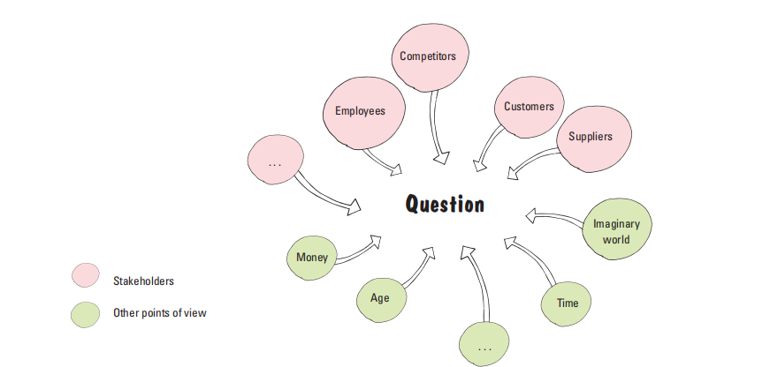

Slide 24
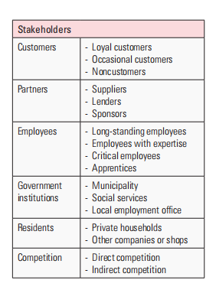

Slide 25
The 5 Whys method
The 5 Whys method isn't inherently part of the define stage in design thinking, but it's a powerful tool that can be used during this critical phase to uncover the root cause of a problem and inform a user-centered approach to defining it.

Slide 26
how the 5 Whys method works in design thinking:
Uncover Underlying Needs: In the define stage, you're taking the user research from the empathize stage and synthesizing it to understand the core issues. The 5 Whys helps you peel back layers of surface-level problems to the underlying needs and motivations of users.
Asking "Why" Repeatedly: You start with the initial problem statement identified through user research. Then, you ask "why" that problem exists, and continue asking "why" in response to each subsequent answer. This repetitive questioning helps you move beyond symptoms to the root cause.
Refining the Problem Statement: By understanding the root cause, you can refine your problem statement to be more user-centered. This refined statement should focus on the user's needs and the opportunities to create solutions that address them.

Slide 27
Example
For instance, imagine you're designing a new library app. Through user research, you discover students are frustrated with long wait times for popular books. Here's how the 5 Whys could be applied:
Why are students frustrated with long wait times?
Because they can't tell if a book is available before going to the library.
Why can't they tell if a book is available?
Because the library app doesn't show real-time inventory.
Why doesn't the app show real-time inventory?

Slide 28
By reaching the root cause (lack of real-time inventory data), you can define the problem statement more precisely: "Students need a way to easily check book availability in real-time to avoid wasted trips to the library.“
This refined problem statement sets the stage for the ideation phase where you'll brainstorm solutions focused on the user's core need for real-time information.

Slide 29
Cause-and-Effect Diagram (Ishikawa Fishbone)
Visually maps potential causes of a problem by categorizing them (e.g., people, materials, methods). For a confusing design layout, the fishbone could explore causes related to user expectations, information hierarchy, or visual clutter.
The Ishikawa Fishbone Diagram, also known as a Cause-and-Effect Diagram, is a visual tool used to identify the root causes of a specific problem. It resembles a fish skeleton, hence the name "fishbone."

Slide 30
How to Use It in Design Thinking:
The Ishikawa Fishbone Diagram is particularly useful in the define stage of design thinking, where you're analyzing user research and defining the core problem statement.
Here's how it can be applied:
Identify the Problem: Clearly define the problem you're trying to understand at the head of the fish.
Brainstorm Categories: Use the 6 Ms as the main bones of the fish.

Slide 31
List Potential Causes: Brainstorm specific causes that could contribute to the problem under each category and sub-categorize as needed.
Analyze and Prioritize: Evaluate the likelihood and impact of each cause. Focus on causes with the highest potential to be the root cause.
Refine the Problem Statement: Based on your analysis, refine your problem statement to be more specific and actionable, considering the root causes identified.

Slide 32
Structure:
Fish Head: The rightmost part of the diagram represents the problem statement you're trying to understand.
Main Bones: Branching off to the left are the major categories of potential causes. A common framework, Ishikawa's 6 Ms, categorizes causes as:
Manpower: Issues related to people involved in the process (e.g., training, skills)
Machine: Problems with equipment or technology used (e.g., malfunctions, limitations)
Method: Flaws in the way the process is carried out (e.g., procedures, communication)
Material: Defects or inconsistencies in the materials used (e.g., quality, suitability)
Measurement: Errors in how data is collected or interpreted (e.g., inaccurate tools, unclear standards)
Mother Nature (Environment): External factors beyond control (e.g., weather, power outages)

Slide 33
Sub-bones:
Further branching off from the main bones are more specific causes related to each category.
You can continue branching out to even finer details as needed.

Slide 34
Benefits:
Visually Organized: The fishbone format helps break down complex problems into a clear and easy-to-understand structure.
Brainstorming Tool: It encourages collaboration and brainstorming by prompting a systematic exploration of potential causes from various angles.
Root Cause Identification: By systematically analyzing contributing factors, you can move beyond surface-level issues and identify underlying root causes.

Slide 35
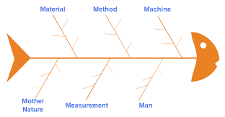
Fishbone Template
Computer
Devices Quality
procedures
Software
suitability
communication
Training
Noise
inaccurate tools
Motivation
weather

